Slide 1
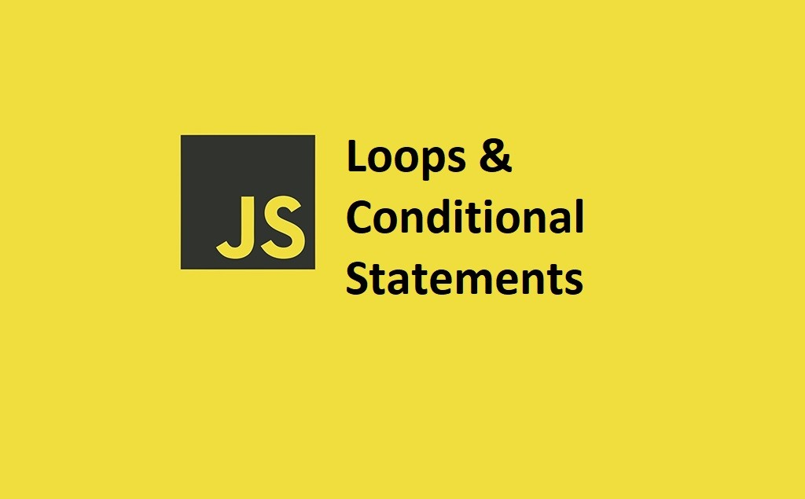

Slide 2
What we Cover Today:
01
02
03
04
05
Truthy and Falsy values
Comparison Operators
Logical Operators
06
If Statement and
If-else Statement
else if Statement
Exercise

Slide 3
Truthy and Falsy values
In JavaScript, every value becomes true or false when we check it in an if statement.
Truthy – a value is truthy if JavaScript thinks it is true.
Falsy – a value is falsy if JavaScript thinks it is false.
False, 0, “”, null, undefined, NaN
Truthy Examples:
if ("Hello") console.log("truthy"); // string with text
if (123) console.log("truthy"); // number
if ([]) console.log("truthy"); // empty array
if ({}) console.log("truthy"); // empty object
if ("0") console.log("truthy"); // string "0"
if ("false") console.log("truthy"); // string "false"

Slide 4
Truthy and Falsy values
Falsy Examples:
if (0) console.log("truthy"); // no output
if ("") console.log("truthy"); // no output
if (null) console.log("truthy"); // no output
if (undefined) console.log("truthy"); // no output
if (NaN) console.log("truthy"); // no output

Slide 5
Comparison Operators
Comparison operators are used to compare two values.
Comparison operators always return true or false. Given x = 5
Operator | Description | Comparing | Returns
== | equal to | x == 8 | false
 |  | x == "5" | true
=== | equal value and equal type | x === 5 | true
 |  | x === "5" | false
!= | not equal | x != 8 | true
!== | not equal value or not equal type | x !== 5 | false
 |  | x !== "5" | true
 |  | x !== 8 | true
> | greater than | x > 8 | false
< | less than | x < 8 | true
>= | greater than or equal to | x >= 8 | false
<= | less than or equal to | x <= 8 | true

Slide 6
Logical Operators
Logical operators are used to combine boolean expressions.
Logical operators can be used to modify the results of comparisons.
Typically, you will use a comparison operator to check a condition, and a logical operator to combine conditions into more complex logic.
Logical AND
The && operator returns true if both expressions are true, otherwise false:
Example :
let x = 6;
let y = 3;
let z = (x < 10 && y > 1) // true

Slide 7
Logical Operators
Logical OR
The || operator returns true if one or both expressions are true, otherwise false:
Example :
let x = 6;
let y = -3;
let z = (x > 0 || y > 0); // true

Slide 8
Logical Operators
Logical NOT
The ! operator returns true for false expressions and false for true expressions.
Example :
let x = (5 == 8);
let y = !(5 == 8); // true

Slide 9
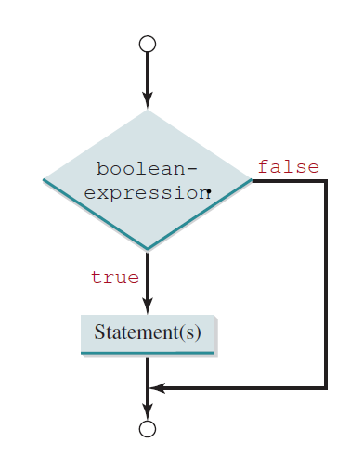
If Statement
Use the if statement to specify a block of Java code to be executed if a condition is true.
Syntax
if (condition) {
// block of code to be executed if the condition is true
}
let x = 20;
let y = 18;
if (x > y) {
console.log(“x is greater than y”);
}
Output: x is greater than y

Slide 10
If-else Statement
Use the else statement to specify a block of code to be executed if the condition is false.
Syntax
if (condition) {
// block of code to be executed if the condition is true
}
else {
// block of code to be executed if the condition is false
}

Slide 11
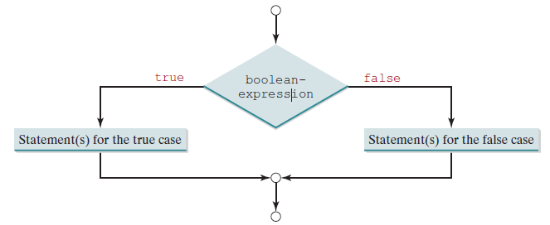
If-else Statement
Example:
let x = 20;
let y = 25;
if (x > y) {
console.log(“x is greater than y”);
}
else {
console.log(“y is greater than x”);
}
Output: y is greater than x

Slide 12
else if Statement
Use the else statement to specify a block of code to be executed if the condition is false.
Syntax
if (condition) {
// block of code to be executed if the condition is true
}
else if (condition) {
// block of code to be executed if the condition1 is false and condition2 is true
}
else {
// block of code to be executed if the condition1 is false and condition2 is false
}

Slide 13
else if Statement
Example:
let time = 17;
if (time < 12) {
System.out.println(“Good Morning”);
}
else if (time < 19) {
System.out.println(“Good afternoon”);
}
else {
System.out.println(“Good evening”);
} Output: Good afternoon

Slide 14
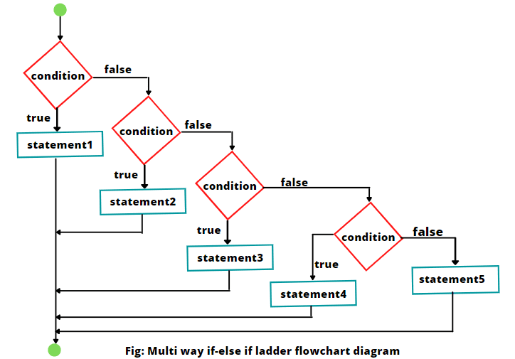
else if Statement

